Slide 1
Raiderville
Making A Positive Future Story

Slide 3
Games
of
Life

Slide 4
How much do
you know about the cost of the REAL WORLD?

Slide 5
1 can of Arizona Ice Tea
$0. 79

Slide 6
Big Mac Meal
$6.29

Slide 7
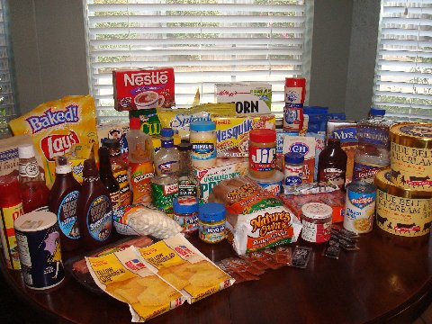
Year Supply of Food For 1 Person
$2,652

Slide 8
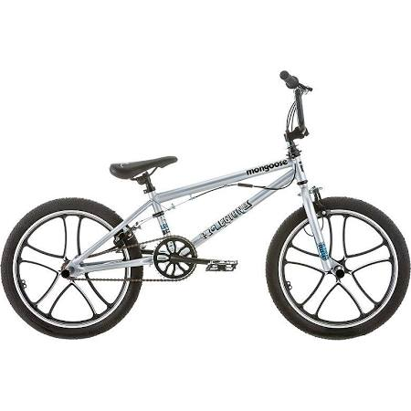
20 in. Mongoose Legion Bike
$134.99

Slide 9
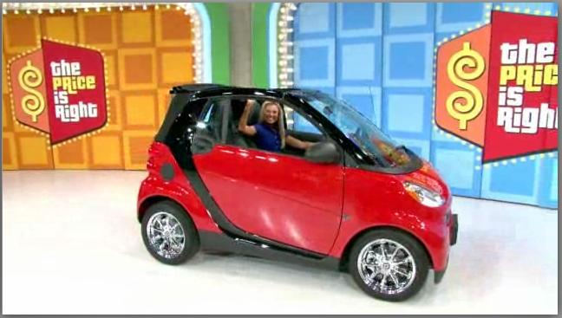
Smart Car
$18,646

Slide 10
Centennial Estates Apt.
Hobart
$665

Slide 11
Trip for 4, 4 nights
$4,052

Slide 12
1 Child For The First Year
$12,000

Slide 13
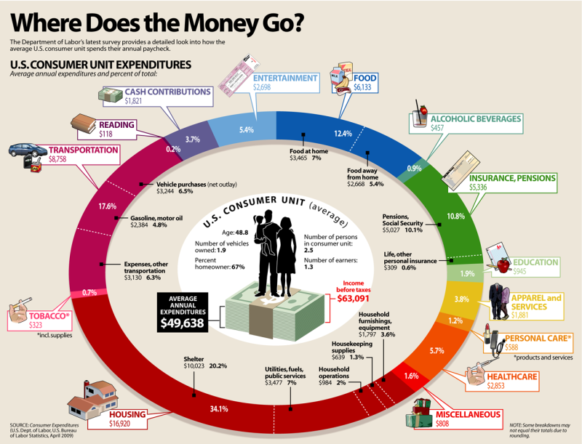

Slide 15
A Positive Future Story

Slide 16
RULES TO THE GAME
1. Life's success is about finding and taking advantage of your OPPORTUNITIES.
2. Educational success = MORE OPPORTUNITES

Slide 17
PICK YOUR GAME PIECE
GPA = a measure of a student’s academic achievement (or habits)
To Find Your GPA…
Change EVERY course grade into a number according to the following:
A= 4.0
B= 3.0
C= 2.0
D= 1.0
F= 0.0
2. Add ALL classes together and divide by number of classes:

Slide 18
0.00 Car
Doesn’t Finish High School
Work
$23,452
2012, Bureau of Labor Statistics

Slide 19
4.0 Car
Finish High School
Work
Tech School
4 year school
Graduate School
Further (Doctoral) School
$33,176
$39,900
$54,756
$65,676
$80,964
2012, Bureau of Labor Statistics

Slide 20
Anesthesiologist $270,000
Surgeon $250,000
CEO $150,000
Therapist $82,390
Lawyer $75,000
Veterinarian $71,000

Slide 21
Engineer $61,523
Marketing/Sales $61,290
Architect $48,000
Teacher $45,181
Accountant $45,000
Social Work $43,990

Slide 22
Police Officer $56,980
Machine Toolmaker $42,000
Graphic Design $40,000
Auto Tech $39,980
Electric Power $61,000
Admin Assist $30,000
Cosmetology $25,000

Slide 23
Dishwasher
Babysitting
Retail (Walmart)
Minimum Wage $7.25
$15,080/yr

Slide 24
Importance Of Our Habits
Routine
Reward
Reminder/
Cue
Common Cues:
Teacher- “You will have the rest of the class to work…”
Teacher- “Your assignment for tomorrow is…”
A cute boy/girl smiles at you as you walk down the hall.

Slide 25
We asked 100 people…
A Husband’s Most Annoying Habit
A Wife’s Most Annoying Habit
1
1
Saying Nothing’s Wrong When Something Is Wrong
Burping and Farting Out Loud

Slide 26
We asked 100 people…
How much more money will a diploma make you over your lifetime?
Percentage of jail inmates without a diploma
1
1
69%
$260,000
http://www.schoolschedulingassociates.com/handouts/DropoutReferences3-22-09.pdf

Slide 27
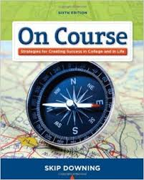
Successful students…
Accept personal responsibility
Are self motivated
Are organized and purposeful
Keep supportive relationships
Know themselves
Continuously learn
Manage their emotions
Believe in themselves
Good student = Good employee
Homework complete = Job finished
On time for class = On time for work

Slide 28
Struggling students…
Think of themselves as victims
Struggle to be motivated
Difficulty planning ahead
Struggle to maintain positive relationships
Choose without thinking
Avoid learning new things
Doubt themselves and their value
Struggling student = Struggling employee
Lazy with homework = Lazy employee
Late for class = Late for work

Slide 29
Don’t Be A “VICTIM”
“The teacher is so boring, they put me to sleep.”
“This class is a stupid requirement.”
“I’ll never understand this subject. It’s a waste of time to study.”
“It’s not my fault that I am late to class.”
“I’ll never do as well as ‘so-and-so,’ S/he’s a genius. “
“I will never be friends with ‘so-and-so,’”
“I’ll try to do better but it’s no use”
“Why do I have learn this? It’s dumb.”

Slide 30
Lessons From
Finally, an exercise in…
G
R
I
T
In 30 seconds, say 50 words that DO NOT contain the letter “A.”

Slide 32
Raiderville
Make a Positive Vision of Your Future!
Develop Good Habits!
Stick To It!
“CREATE” A Positive Future Story

