Slide 1
Energy Performance Contracting Services Under WI Act 32
May 17, 2017
PULASKI COMMUNITY
SCHOOL DISTRICT
FOUNDED ON TRADITION AND PRIDE, FOCUSED ON EXCELLENCE

Slide 2
History of Act 32 in PCSD
Research:
Investigate experiences of other districts
2016-2017 school year –
Investigate viability of project for PCSD
Meet with potential Energy Savings Contractors
Receive feedback on needs and potential projets
Consult with Bond Counsel, Financial Advisor, and Legal
PULASKI COMMUNITY
SCHOOL DISTRICT
FOUNDED ON TRADITION AND PRIDE, FOCUSED ON EXCELLENCE

Slide 3
History of Act 32 in PCSD
March 15, 2017 –
Presented initial information to the Board of Education
Viable option to fund many items on our 10 year maintenance plan
Timing
Health of the District
Act 32 investigation continues through a Request for Qualifications (RFQ)
PULASKI COMMUNITY
SCHOOL DISTRICT
FOUNDED ON TRADITION AND PRIDE, FOCUSED ON EXCELLENCE

Slide 4
History of Act 32 in PCSD
March 17-28, 2017 – RFQ Period (5 proposals received)
April 5, 2017 – Acceptance of recommdnation of H&H for evaluation, design, and planning
April 6-20, 2017 – Phase I facilities audit
April 26, 2017 – Authorization for initial borrowing authority and scope of work approved
PULASKI COMMUNITY
SCHOOL DISTRICT
FOUNDED ON TRADITION AND PRIDE, FOCUSED ON EXCELLENCE

Slide 5
History of Act 32 in PCSD
Scope of Work $8.5 M
Projects benefiting students in every building
Projects with operations and mainteance savings
Improved learning environments
Protect investment in our facilities
Tax Levy Impact
Mill rate history
Retiring debt
Project benefits and lowest mill rate since 2008-2009
PULASKI COMMUNITY
SCHOOL DISTRICT
FOUNDED ON TRADITION AND PRIDE, FOCUSED ON EXCELLENCE

Slide 6
PCSD Mill Rate History
2007-2008 $8.75
2008-2009 $8.34
2009-2010 $8.90
2010-2011 $9.24 Projected 2017-2018
2011-2012 $9.61 with Act 32 Energy
2012-2013 $9.82 St. Avg. Project: $8.48
2013-2014 $9.83 $10.37
2014-2015 $9.77 $10.26 ** Decrease in Mill
2015-2016 $8.84 $10.25 Rate by $0.13
2016-2017 $8.61 $9.97
PULASKI COMMUNITY
SCHOOL DISTRICT
FOUNDED ON TRADITION AND PRIDE, FOCUSED ON EXCELLENCE

Slide 7
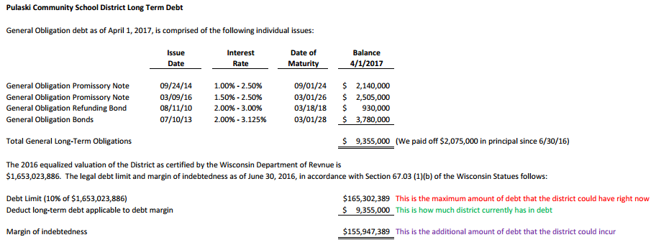
PCSD Long Term Debt Outlook
PULASKI COMMUNITY
SCHOOL DISTRICT
FOUNDED ON TRADITION AND PRIDE, FOCUSED ON EXCELLENCE

Slide 8
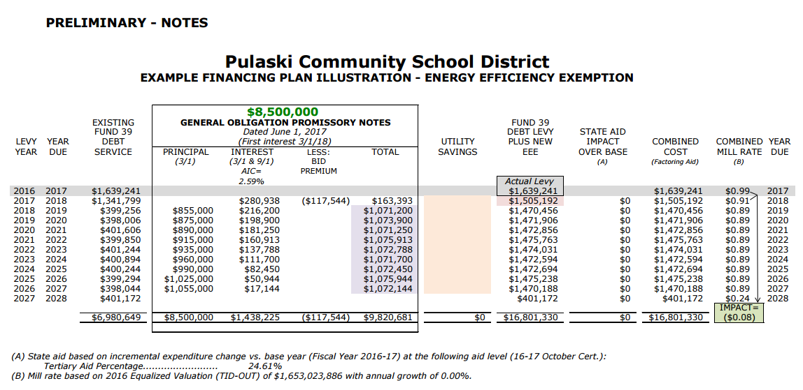
PULASKI COMMUNITY
SCHOOL DISTRICT
FOUNDED ON TRADITION AND PRIDE, FOCUSED ON EXCELLENCE

Slide 9
Formal Requirements
April 28, 2017 - Request for Proposals (RFP) sent to all respondents from initial RFQ
April 29, 2017 – Notice to Electors (adopted resolution) printed in GB Press Gazette
May 3, 2017 - Pnoticed May 17, 2017 meeting to consider a proposal to negotiate an energy savings performance contract
May 11, 2017 - RFP due to PCSD
PULASKI COMMUNITY
SCHOOL DISTRICT
FOUNDED ON TRADITION AND PRIDE, FOCUSED ON EXCELLENCE

Slide 10
Pulaski Community School District Energy Savings Project Presentation
The Facility & Energy Experts

Slide 11
Benchmarking
Facility Name | Size (sq-ft) | Annual Utility Cost ($) | $/sq-ft | kWh/sq-ft | Therms/sq-ft | Total kBtu/sq-ft
Pulaski High School (PHS) | 317,191 | $197,966 | $0.62 | 4.5 | 0.22 | 37.4
Pulaski Community Middle School (PCMS) | 222,628 | $176,275 | $0.79 | 4.2 | 0.46 | 60.4
Glenbrook Elementary School | 129,066 | $99,068 | $0.77 | 4.4 | 0.22 | 36.7
Hillcrest Elementary School | 64,244 | $32,954 | $0.51 | 3.2 | 0.19 | 29.4
Sunnyside Elementary School | 61,180 | $38,477 | $0.63 | 3.9 | 0.12 | 25.1
Lannoye Elementary School | 55,311 | $24,313 | $0.44 | 3.0 | 0.24 | 34.6
Fairview Elementary School | 31,000 | $26,744 | $0.86 | 3.2 | 0.40 | 50.3
Bus Garage | 4,500 | $9,521 | $2.12 ** | 11.7 | 0.73 | 112.7
Totals | 885,120 | $605,318 | $0.68
a

Slide 12
Utility Bill Charges
School Name | kW (Demand) | kWh (Energy) | $/Therm
Fairview Elementary | $22.57 | $0.03500 | $0.6410
Lannoye Elementary | $0.00 | $0.09477 | $0.5240
Sunnyside Elementary | $11.59 | $0.06458 | $0.6630
Hillcrest Elementary | $11.59 | $0.06458 | $0.5290
Glenbrook Elementary | $13.80 | $0.07842 | $0.6180
Middle School | $13.80 | $0.07842 | $0.5640
High School | $11.59 | $0.06458 | $0.5930
Bus Garage | $0.00 | $0.13282 | $0.8000

Slide 13
Cost Breakout by location
Facility | Total Project Cost
Fairview Elementary | $279,602
Lannoye Elementary | $758,099
Sunnyside Elementary | $810,515
Hillcrest Elementary | $792,245
Glenbrook Elementary | $1,231,487
Middle School | $1,854,592
High School* | $2,758,378
Bus Garage | $16,759
Total | $8,501,676
*Total Project Cost includes $1,617,000 for new roof
a

Slide 14
Annual Savings
Facility | Annual Utility Cost (Normalized)* | Est. Annual Energy Savings ($) | Est. Annual O&M Savings ($) | Long Term Operational Savings (LTOS) | % Energy Savings | Simple Payback
Fairview Elementary | $26,744 | $6,134 | $8,060 | $12,051 | 23% | 9.5
Lannoye Elementary | $28,950 | $7,010 | $9,956 | $33,319 | 24% | 13.6
Sunnyside Elementary | $49,834 | $10,790 | $17,130 | $34,691 | 22% | 11.7
Hillcrest Elementary | $40,091 | $12,094 | $17,988 | $32,235 | 30% | 11.4
Glenbrook Elementary | $113,425 | $27,150 | $39,386 | $52,806 | 24% | 9.2
Middle School | $176,275 | $30,134 | $62,336 | $69,726 | 17% | 9.2
High School | $231,823 | $37,302 | $57,094 | $100,933 | 16% | 10.2
Bus Garage | $9,521 | $1,490 | $90 | $547 | 16% | 12.6
Total | $676,664 | $132,103 | $212,041 | $336,309 | 20% | 12.5
*Normalization to accommodate needed fresh air and various variable such as weather, hours of operations, etc…

Slide 15
Project Location Breakout
Code | Project | Project Scope location
1 | Upgrade Interior lighting to LED | X,BG
1 | Upgrade remaining exterior lights to LED | X,BG
2 | Building Weatherization & Insulation | X,BG
3 | Energy Recovery Ventilators (ERVs) | X
3 | Demand Controlled Ventilation (DCV) | X
3 | Upgrade pneumatics to DDC for building controls | SS,HC,GB,MS
3 | HVAC projects and improvements | LN,SS**,HC,GB**,MS**,HS,BG
3 | Upgrade aged water heaters | FV
4 | Upgrade aged kitchen equipment | X
5 | Replace aged roofing areas | FV,LN,SS,HC,GB,MS,HS
6 | Window Replacement | SS,HC
 | Code
All School Buildings | X
Fairview Elementary | FV
Lannoye Elementary | LN
Sunnyside Elementary | SS
Hillcrest Elementary | HC
Glenbrook Elementary | GB
Middle School | MS
High School* | HS
Bus Garage | BG

Slide 16
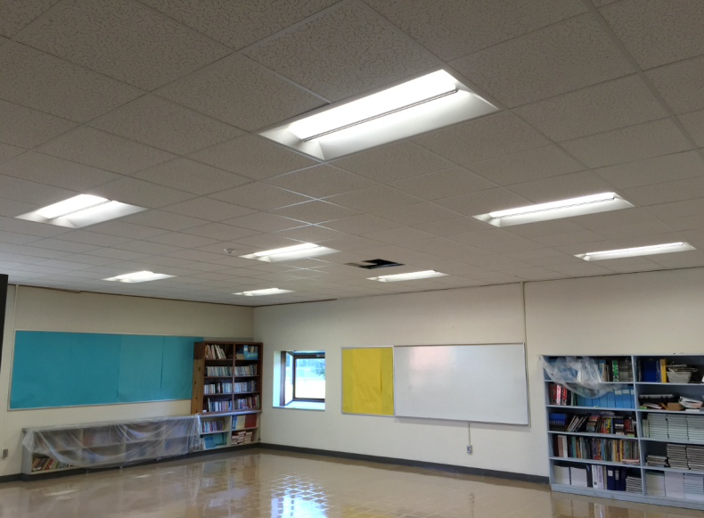
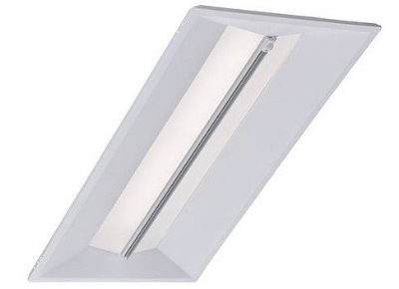
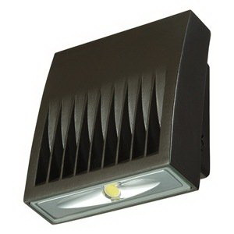
1: LED Lighting
Project Includes:
LED indoor lighting fixtures
LED outdoor lighting (remaining areas)
Benefits:
Long lasting, expected life of 25+ years
5 or 10 year manufacturer warranties
Reduced operations and maintenance costs
Improved quality and uniformity of light
Better learning environment
50%+ energy reduction compared to existing

Slide 17
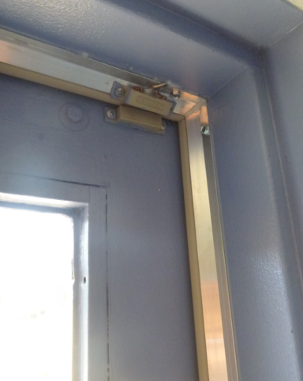
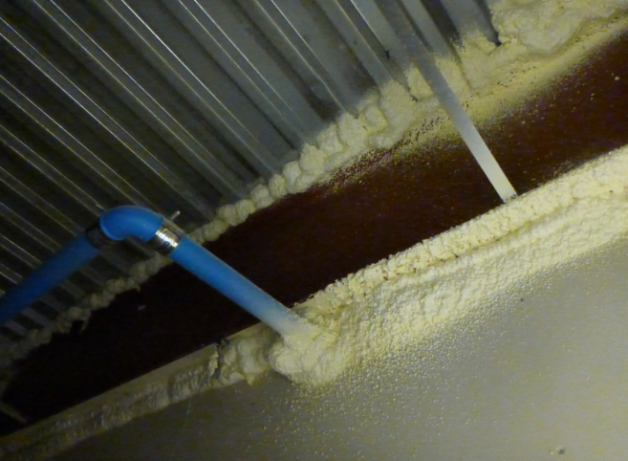
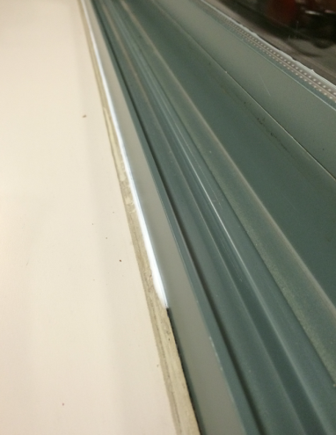
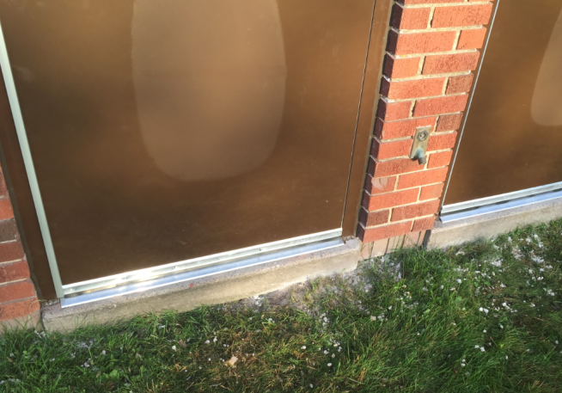
2. Building Weatherization & Insulation
Project Includes:
Weather-strip and seal exterior doors and interior doors to unconditioned rooms
1-part and 2-part foam on roof/wall joints
Caulk windows, 1 line at perimeter
Benefits:
Reduce air infiltration
Reduce thermal energy loss
Improve occupant comfort (reduce draftiness)

Slide 18
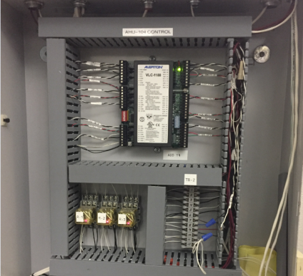
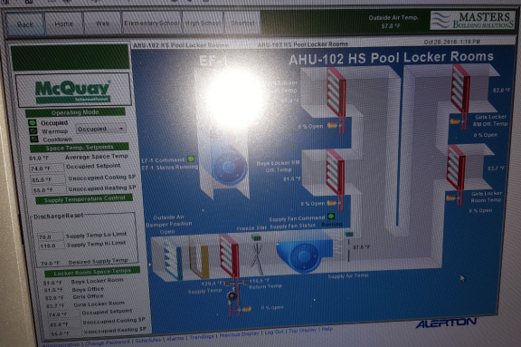
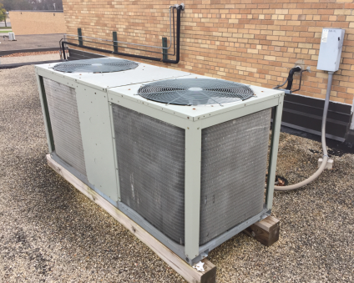
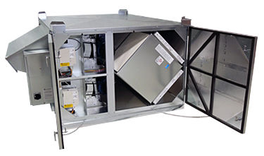
3. HVAC Upgrades
Project Includes:
Replace outdated pneumatics to DDC controls and update existing DDC software/front end to latest version
Replace older HVAC & water heater equipment
Install energy recovery ventilators (ERVs)
Install demand controlled ventilation
Benefits:
Replace outdated equipment
Reduce maintenance costs
Improved building performance and occupant comfort
Save energy, better scheduling
Improve air quality

Slide 19
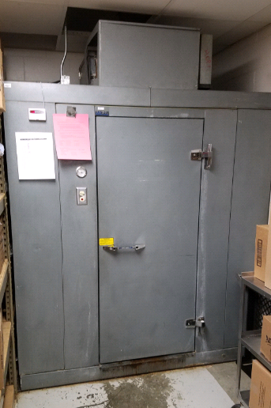
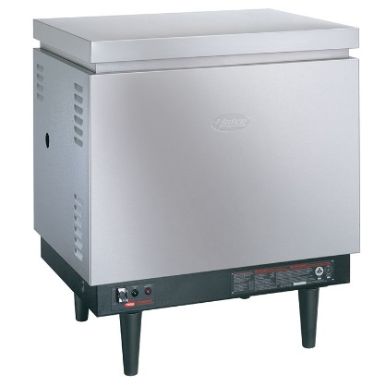
4. Kitchen Upgrades
Project Includes:
Replace walk-in freezer/coolers as needed
Replace electric booster heater for dishwasher with a natural gas fired unit
Benefits:
Replace equipment that is past typical service life
Reduce demand (kW) costs associated with operating an electric booster heater & use a cheaper fuel source

Slide 20
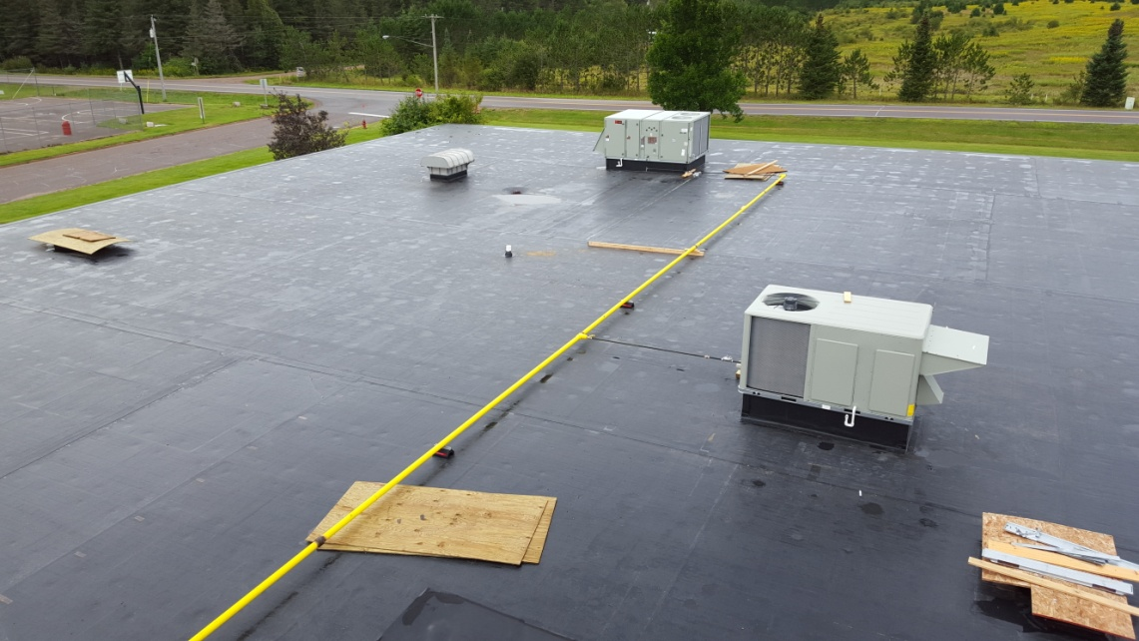
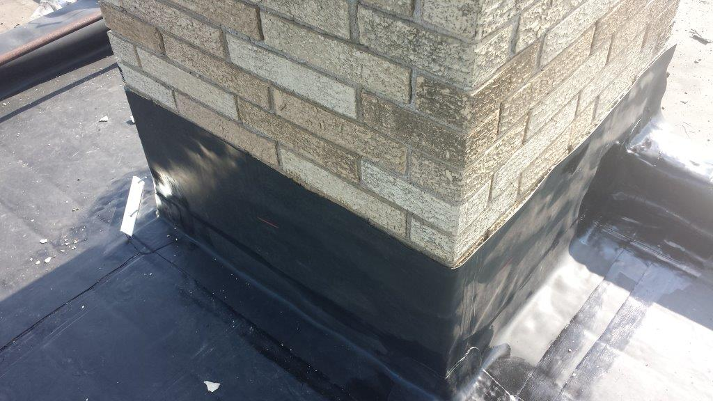
5. Replace aged roofing areas
Project Includes:
Replace aged roof sections that are at or beyond useful life.
Benefits:
Roof systems are well past the typical service life and are no longer under warranty
New roof system would include 20 year no dollar limit manufacturer warranty
Investigate replacement of insulation and possibility of adding more R-value

Slide 21
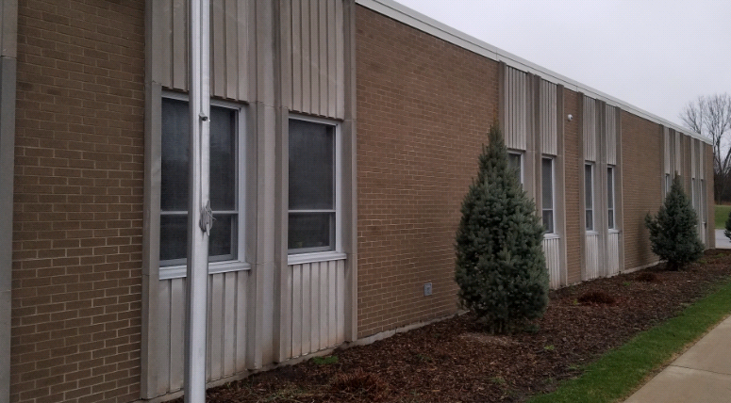
6. Window Replacement
Project Includes:
Replace aged and failing windows
Benefits:
Maintain or install adjustable windows
Minimized temperature gradient by windows
Investigate replacement of insulation around windows for better weatherization

Slide 22
Questions?
The Facility & Energy Experts

Slide 23
Next Steps
RFP Responses –
As Expected, H&H was the only respondent to the RFP for Energy Savings Performance Contract
Recommended from RFQ process
Conducted phase 1 assessment
Board Action – (INSERT LANUGAGE FOR BOARD MOTION HERE)
PULASKI COMMUNITY
SCHOOL DISTRICT
FOUNDED ON TRADITION AND PRIDE, FOCUSED ON EXCELLENCE

